Slide 1
Context-Free Grammar

Slide 2
Outline
Context-Free Grammars
Ambiguity Grammars
Chomsky Normal Form
Conversion to Chomsky Normal Form

Slide 3




Context-Free Language
Context-Free Languages
Regular Languages

Slide 4
Context-Free Languages
Context-Free
Grammars
Pushdown
Automata
stack
automaton

Slide 5

Grammars
Grammars express languages
Example: the English language grammar

Slide 6
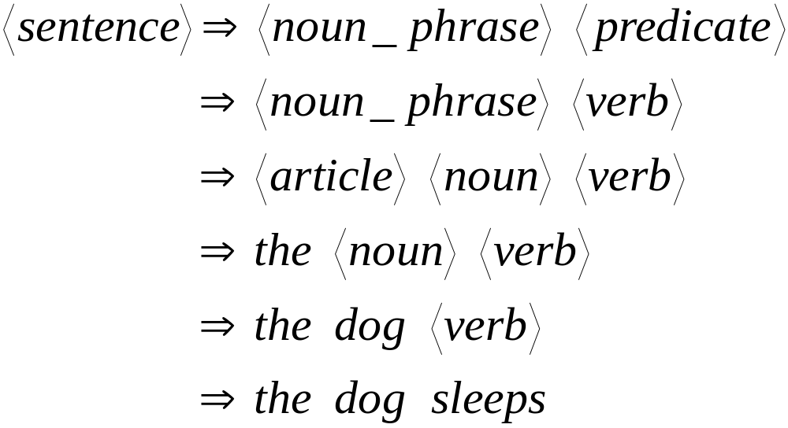
Derivation of string “the dog sleeps”:

Slide 7
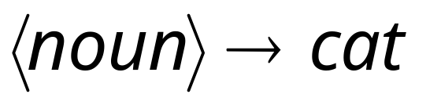
Productions
Sequence of
Terminals (symbols)
Variables
Sequence of Variables

Slide 8
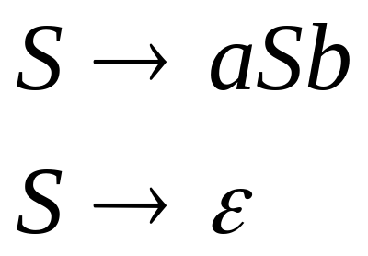

Grammar:
Language of the grammar:

Slide 9

A Convenient Notation
We write:
Instead of:
for zero or more derivation steps

Slide 10

Formal Definitions
Grammar:
Set of
variables
Set of
terminal
symbols
Start
variable
Set of
productions

Slide 11


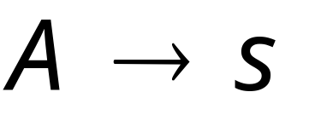
Context-Free Grammar:
All productions in are of the form
Variable
String of
variables and
terminals

Slide 12
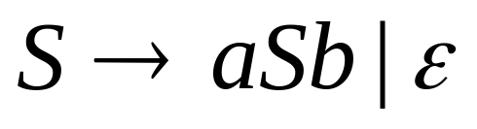



Example
productions
start variable
variables
terminals

Slide 13
Context-Free Language definition:
A language L is context-free
if there is a context-free grammar G
with L = L(G)

Slide 14
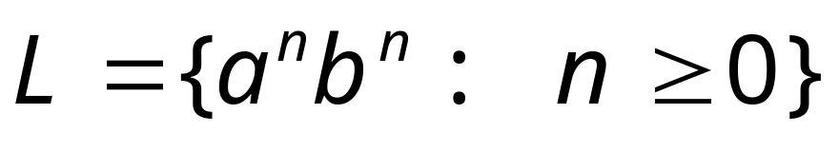

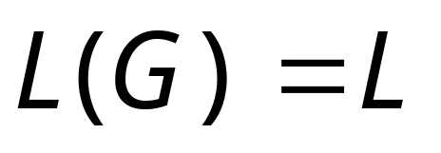
Example:
is a context-free language
since context-free grammar G :
generates

Slide 15
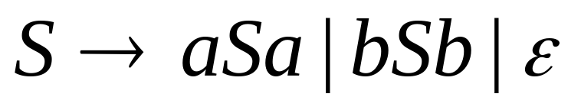
Another Example:
Context-free grammar G :
Example derivations:

Slide 16


Ambiguous Grammar:
A context-free grammar is ambiguous
if there is a string which has:
two different derivation trees or two leftmost derivations.
(A derivation of a string w in a grammar G is a leftmost derivation if at every step the leftmost remaining variable is the one replaced.
Two different derivation trees give two different leftmost derivations and vice-versa)

Slide 17
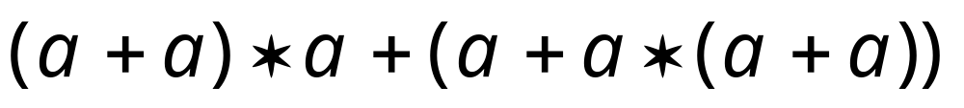
Grammar for mathematical expressions
Example strings:
Denotes any number

Slide 18









Good Tree
Bad Tree
Compute expression result
using the tree

Slide 19


Example:
this grammar is ambiguous since
string
has two derivation trees

Slide 20
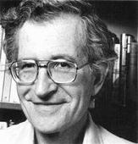


Chomsky Normal Form
Each production has form:
Chomsky
or
variable
variable
terminal
  Where a is any terminal and A,B,C are any variables—except that B and C may not be the start variable. In addition we permit the rule S →ε, where S is the start variable

Slide 21
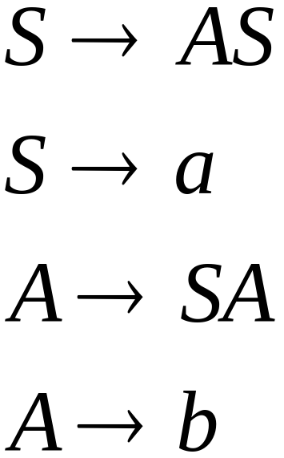
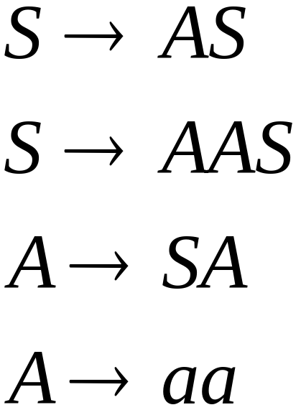
Examples:
Chomsky
Normal Form
Not Chomsky
Normal Form

Slide 22
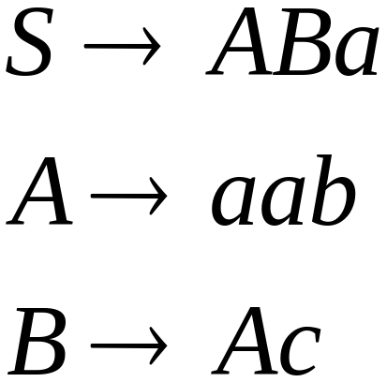
Conversion to Chomsky Normal Form
Example:
Not Chomsky
Normal Form
We will convert it to Chomsky Normal Form

Slide 23
Conversion Sequence
Step 1: Add new start state S₀ and rule S₀->S
Step 2: Remove ε rules, e.g. A-> ε
Step 3: Remove Unit-Productions
Step 4: Convert into proper form
This sequence guarantees that
unwanted variables and productions
are removed

Slide 24
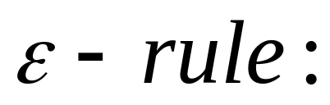
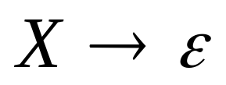
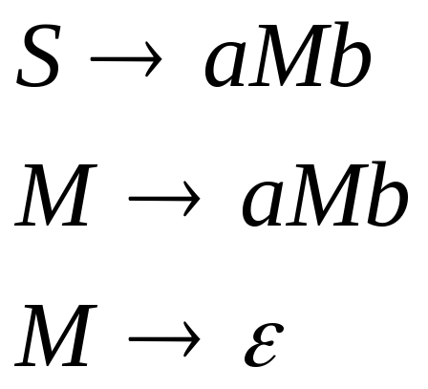
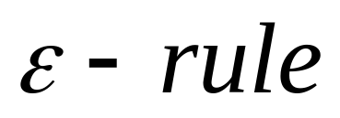
ε rules
Example:

Slide 25
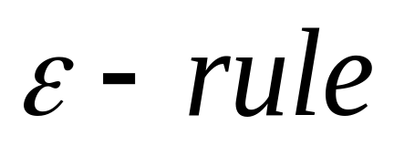

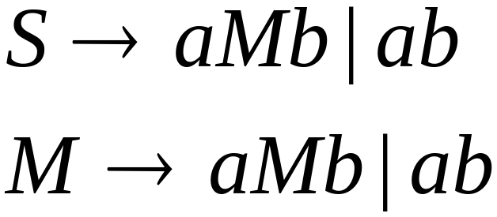


Removing
Substitute
After we remove all the
all the nullable productions are disappeared
(except for the start variable)

Slide 26

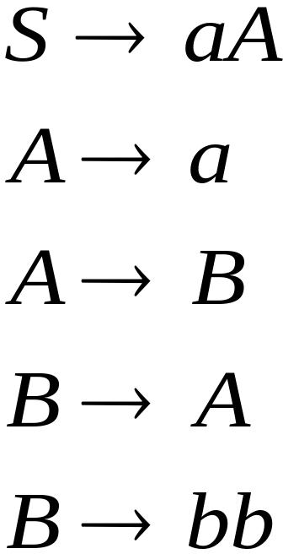
Unit-Productions
Unit Production:
(a single variable in both sides)
Example:
Unit Productions

Slide 27
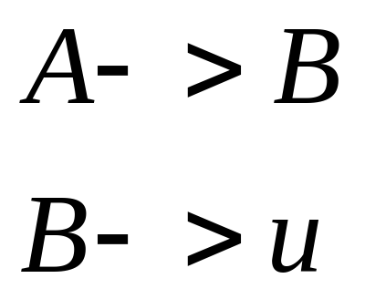
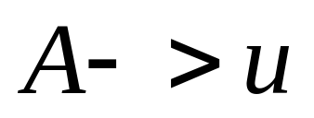

Removal of unit productions:
Substitute

Slide 28

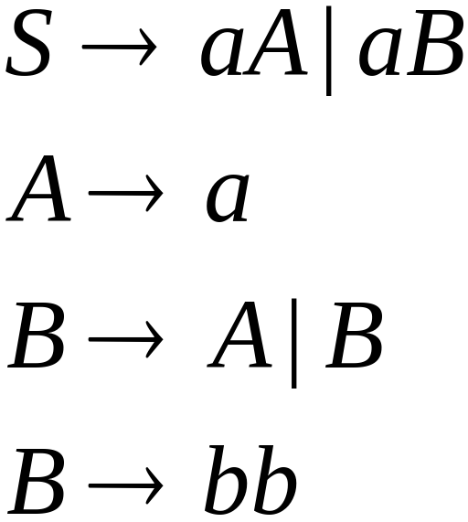
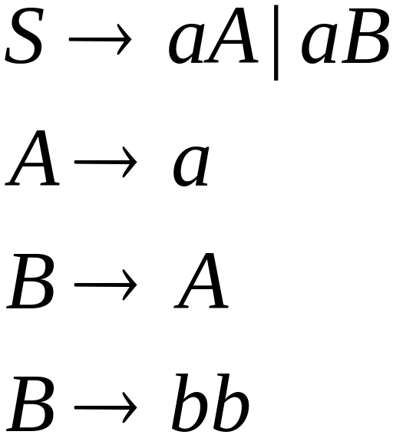

Unit productions of form
can be removed immediately
Remove

Slide 29
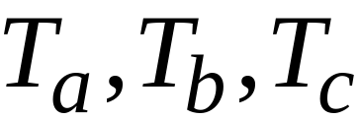
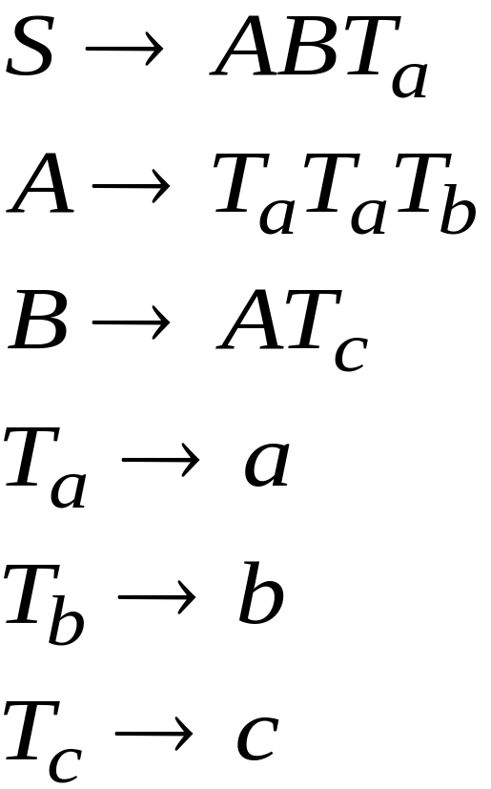
Introduce new variables for the terminals:

Slide 30
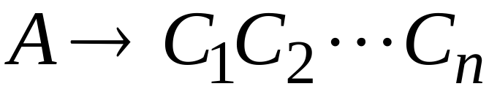
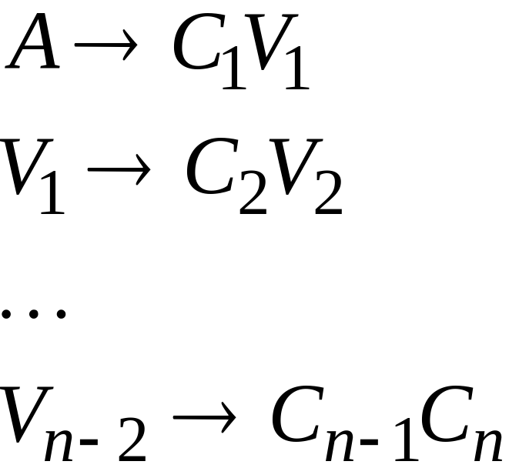
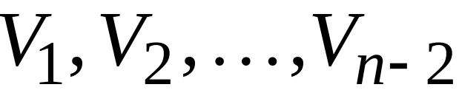
Replace any production
with
New intermediate variables:

Slide 31

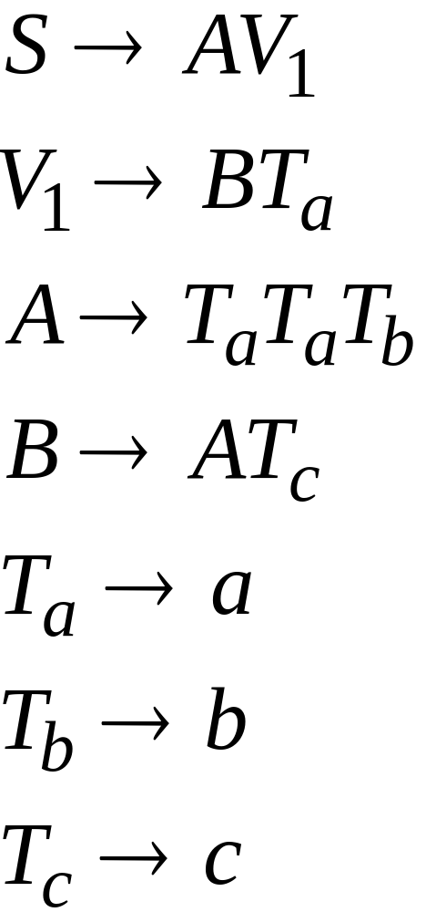
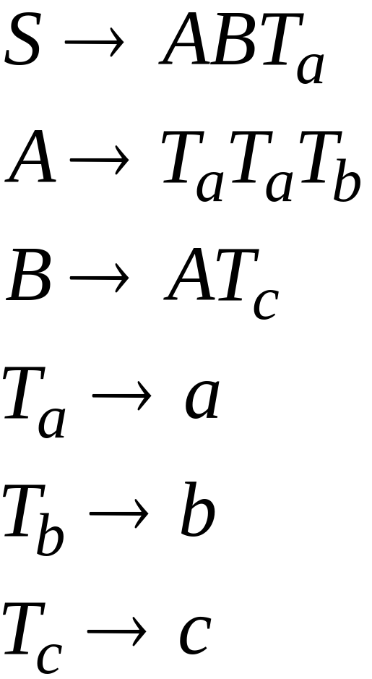
Introduce new intermediate variable
to break first production:

Slide 32
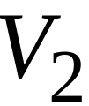
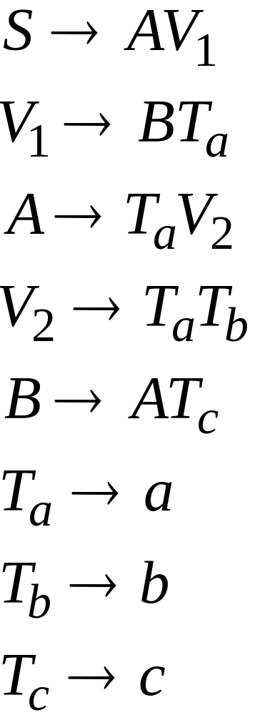
Introduce intermediate variable:

Slide 33
Final grammar in Chomsky Normal Form:
Initial grammar

Slide 34
Observations
Chomsky normal forms are good
for parsing and proving theorems
It is easy to find the Chomsky normal
form for any context-free grammar

Slide 35
Example
Context-free grammar
  S→ASA|aB
  A→B|S
    B→b|ε
1. Add the start state and the rule S₀->S
  S₀→S
  S→ASA|aB
  A→B|S
    B→b|ε

Slide 36
2. Remove ε rules, B-> ε
  S₀→S
  S→ASA|aB
  A→B|S
    B→b|ε
Remove ε rules, A-> ε
  S₀→S
  S→ASA|aB|a
  A→B|S|ε
    B→b
  S₀→S
  S→ASA|aB|a|SA|AS|S
  A→B|S
  B→b

Slide 37
3. remove S->S, remove S₀->S
Remove A->B, remove A->S
  S₀→S
  S→ASA|aB|a|SA|AS
  A→B|S
  B→b
  S₀→ASA|aB|a|SA|AS
  S→ASA|aB|a|SA|AS
  A→B|S
  B→b
  S₀→ASA|aB|a|SA|AS
  S→ASA|aB|a|SA|AS
  A→S|b
  B→b
  S₀→ASA|aB|a|SA|AS
  S→ASA|aB|a|SA|AS
  A→b|ASA|aB|a|SA|AS
  B→b

Slide 38
Finally, add additional variables and rules
  S₀→ASA|aB|a|SA|AS
  S→ASA|aB|a|SA|AS
  A→b|ASA|aB|a|SA|AS
  B→b
  S₀→AA₁|UB|a|SA|AS
  S→AA₁|UB|a|SA|AS
  A→b|AA₁|UB|a|SA|AS
  A₁→SA
  U→a
  B→b

Slide 39
Review
Context-Free Grammars
Ambiguity Grammars
Chomsky Normal Form
Conversion to Chomsky Normal Form

